Slide 1
Nifty50 forecasting and trading strategies
Barbieri Claudio, Delera Giacomo, Huser Cyril, Howe Alessandro
Econometrics project 2024/2025
Lecturer: Azzone Michele
TA: Sala Edoardo

Slide 2

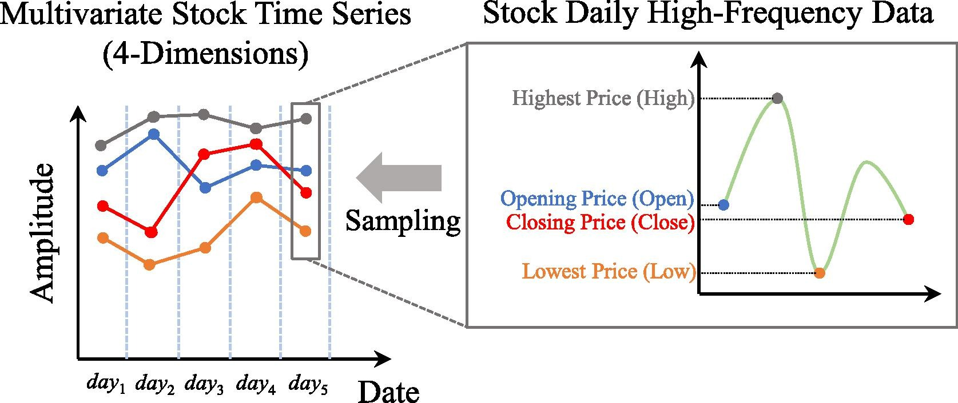
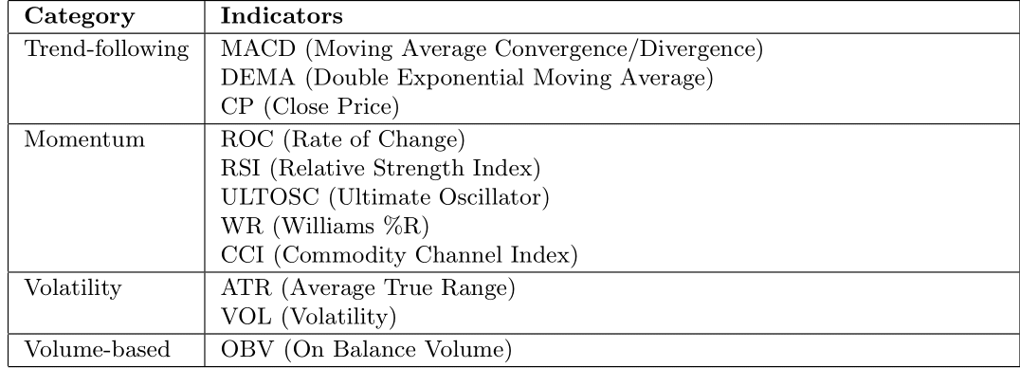
Data
Indexes
Stocks
High-frequency (minute-level) data of the Indian stock market from 2017 to 2021
Select Nifty50 index data from 2017,2018, and 2019 to avoid the COVID-19 pandemic
Aggregate into daily Open High Low Close prices to reduce noise level
Extract a proxy for the index Volume from the constituent underlying stocks
Compute some technical indicators to use as features

Slide 3
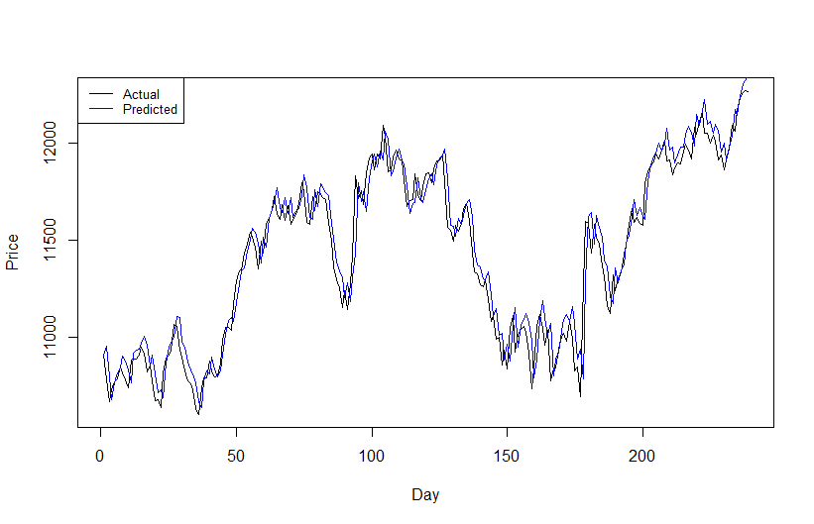


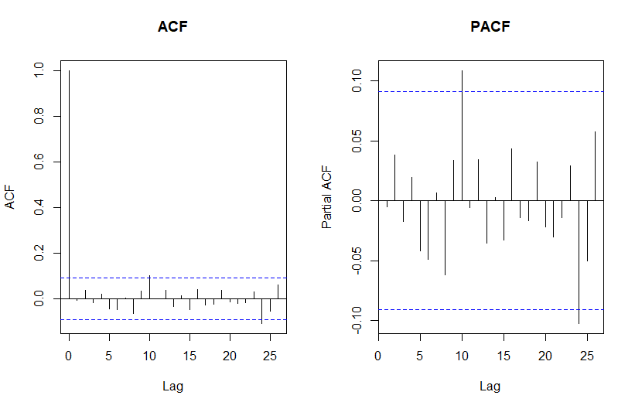
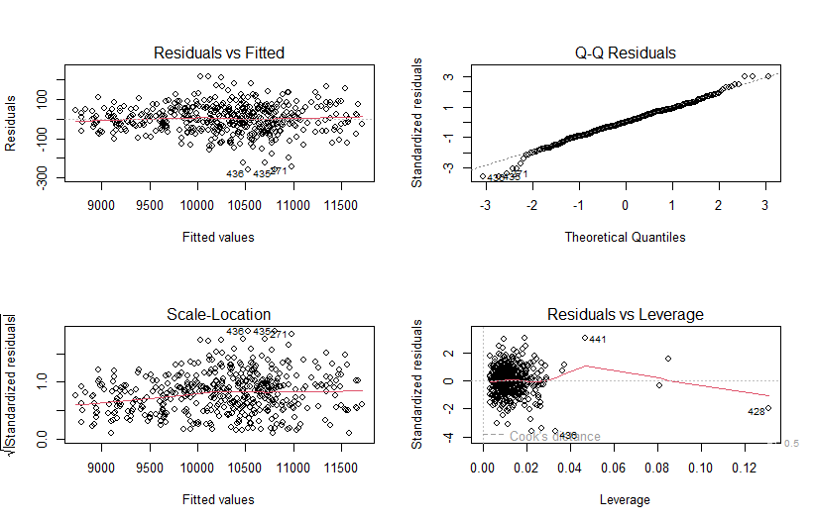

Linear Model
Predict the close price of Nifty50 using technical indicators
with a linear regression model
Variable selection: backward/forward minimizing AIC
Training set: 2017, 2018
Test set: 2019
No interest in the statistical reliability here,
just focus on the forecast power
Spurious high R² from non-stationary features
Heteroskedastic residuals
Non-normal error distribution
Diagnostics for guiding future modeling
No autocorrelation detected after including lagged values

Slide 4
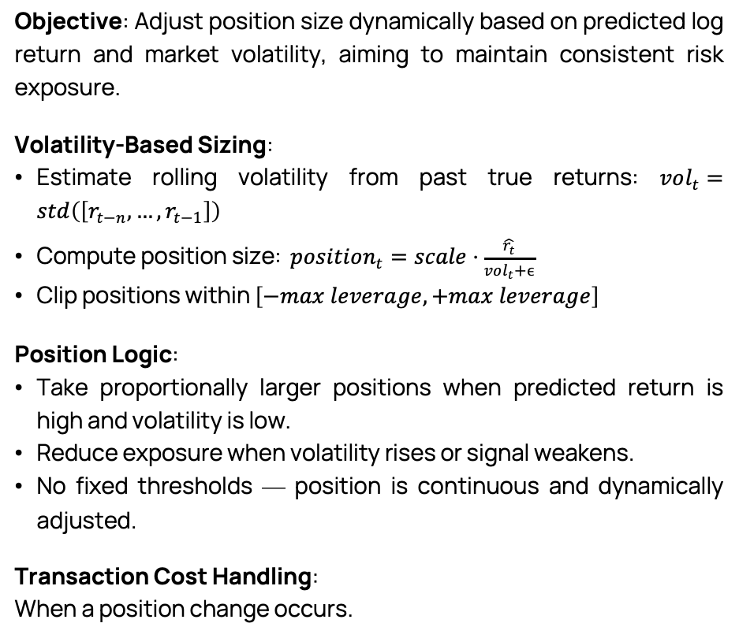
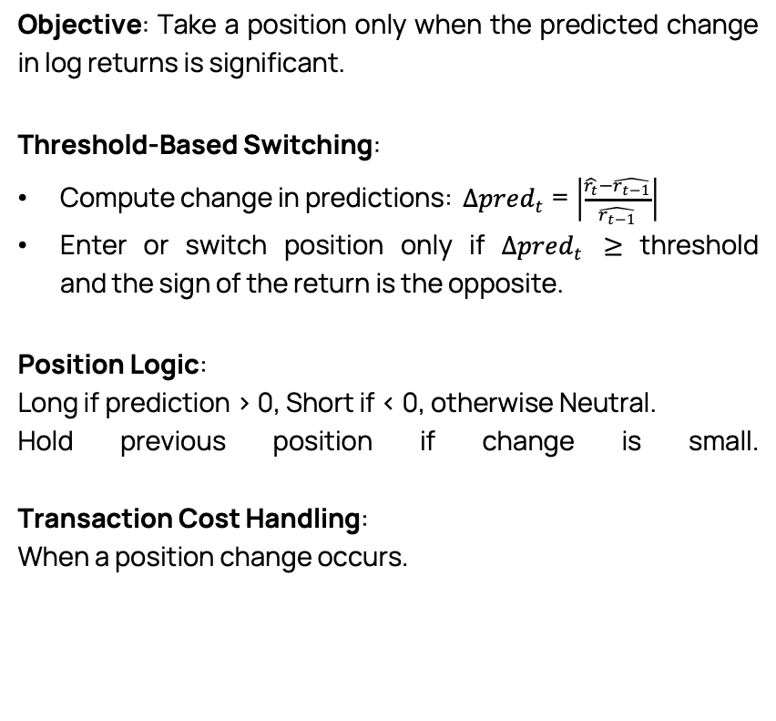
Absolute Change Threshold Strategy
Trading strategies
Volatility-Scaled Strategy
Objective: Take a position only when the predicted change in log returns is significant.
Threshold-Based Switching:
Compute change in predictions: $Δpred_{t}$= $\left|\frac{\hat{r_{t}}−\hat{r_{t−1}}}{\hat{r_{t−1}}}\right|$
Enter or switch position only if $Δpred_{t}$ ≥ threshold and the sign of the return is the opposite.
Position Logic:
Long if prediction > 0, Short if < 0, otherwise Neutral.
Hold previous position if change is small.
Transaction Cost Handling:
When a position change occurs.
Objective: Adjust position size dynamically based on predicted log return and market volatility, aiming to maintain consistent risk exposure.
Volatility-Based Sizing:
Estimate rolling volatility from past true returns: $vol_{t}=std\left(\left[r_{t−n},…,r_{t−1}\right]\right)$
Compute position size: $position_{t}=scale⋅\frac{\hat{r_{t}}}{vol_{t}+ϵ}$
Clip positions within $\left[−max leverage,+max leverage\right]$
Position Logic:
Take proportionally larger positions when predicted return is high and volatility is low.
Reduce exposure when volatility rises or signal weakens.
No fixed thresholds — position is continuous and dynamically adjusted.
Transaction Cost Handling:
When a position change occurs.

Slide 5
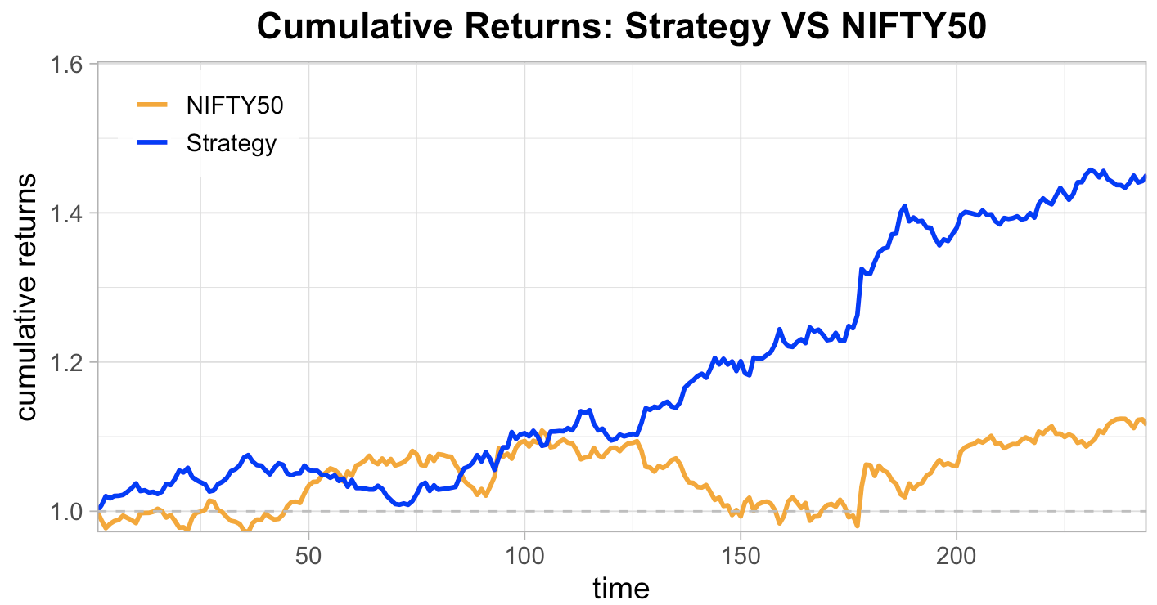
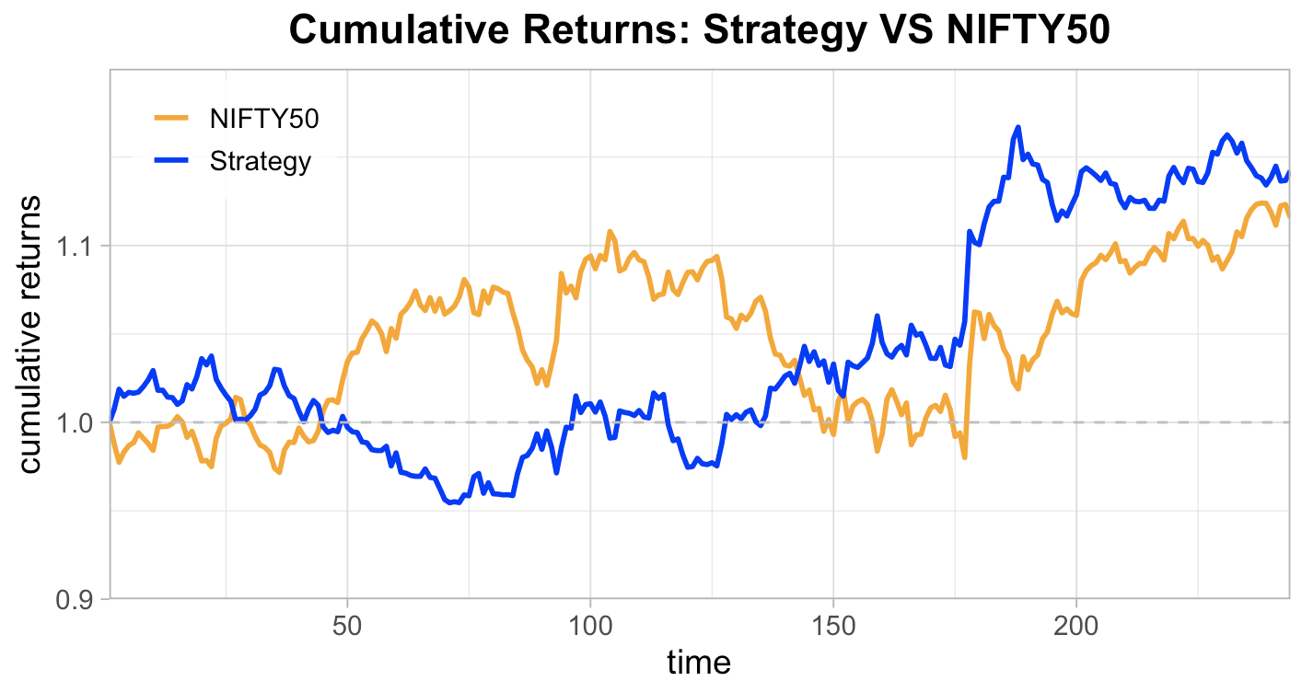
Fixed Threshold Sign Strategy
Objective: Daily trading strategy, taking long or short positions based on the predicted log return. While not the most advanced approach, it best allowed us to evaluate the index forecast — our primary objective.
Signal-Based Positioning:
Long if prediction > threshold, Short if < -threshold, Neutral otherwise.
2 Variants:
Log(Close/Previous Close) measures the daily return, encompassing both overnight and intra-day price changes between two consecutive closes.
Log(Close/Open) captures the intra-day return, reflecting the price movement from the market open to close within the same trading day.
.
Even if the 2nd is the “classical” definition of log return, strategies based on Log(Close/Open) often provide more consistent and reliable signals for short-term trading.
Transaction Cost Handling:
When a position change occurs.
Exiting and entering the market costs.
The impact of transaction costs:
Annualized Return: 44.22%
Sharpe Ratio: 3.13
Max Drawdown: 4.79%
Sortino Ratio: 6.33
TRANSACTION COSTS
Annualized Return: 14.73%
Sharpe Ratio: 1.21
Max Drawdown: 8.00%
Sortino Ratio: 2.28

Slide 6
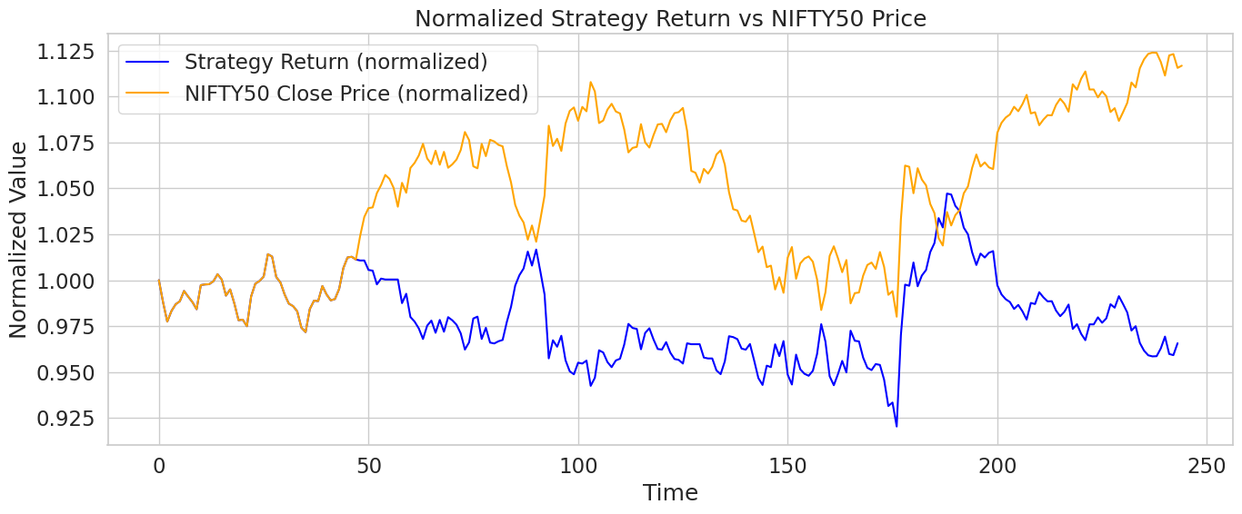
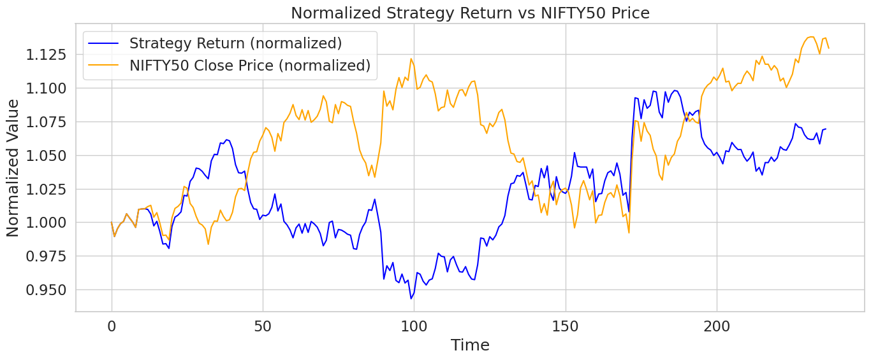
(Conv-)LSTM
Whole-day trading
Leverages LSTM’s sequence “memory” plus local feature extraction via 1D convolutions, common in financial forecasting literature
Input tensor: N x W x F
N: total samples (sliding windows)
W: window size (days of history)
F: features per day
Annualized Return: -3.12% Max Drawdown: 9.49%
Sharpe Ratio: -0.16 Sortino Ratio: -0.28
Sliding-window encoding
stride 1 (one-day step)
many-to-one (single output)
Feature scaling: Min-Max scaling
Option 1: NIFTY50 (prior‑day log‑return + prior-day volume + technical indicators)
Option 2: NIFTY50 + SP500 (prior‑day NIFTY50 and SP500 log-return + prior-day NIFTY50 and SP500 volume + NIFTY50 technical indicators
Annualized Return: 5.95% Max Drawdown: 11.13%
Sharpe Ratio: 0.49 Sortino Ratio: 0.78

Slide 7
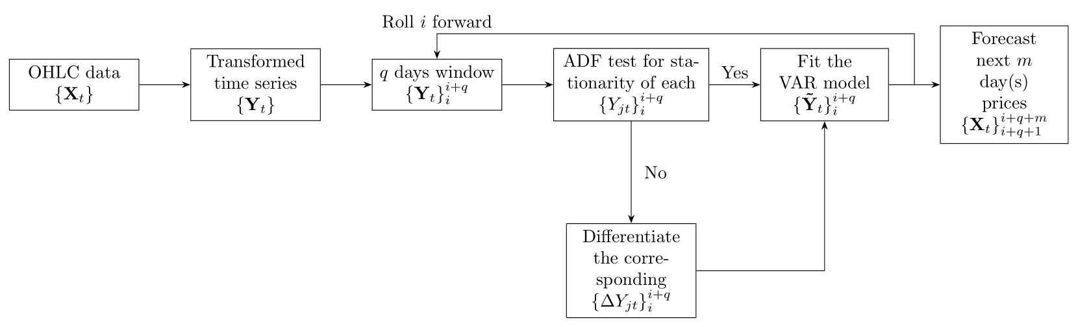
VAR on OHLC
1: Get the raw candlestick charts with T periods from the capital market; 2: Extract the four-dimensional time series data of the candlestick charts, record as {Xt} T t=1; 3: Conduct transformation method to {Xt} T t=1 and obtain {Yt} T t=1 according to Eq.(8); 4: Model {Yt} T t=1 via prediction models to get forecasted future values Ybt ; 5: Conduct inverse transformation method to Ybt according to Eq.(9) and the original forecaster of OHLC data Xct can be derived
-----------------------------------------------------------------------------------------------------
1: Divide {Yt} T t=1 into segments Y (q) i , each segment involves q periods, and each segment rolls forward by one period; 2: Conduct ADF test on the four-dimensional time series data in Y (q) i . If they are all stationary processes, proceed to Step 5, otherwise proceed to Step 3; 3: Use Johansen method to perform the co-integration test on Y (q) i , and determine r. If there is a co-integration relationship, proceed to Step 6, otherwise go to Step 4; 4: Take one-order difference on non-stationary time series in Y (q) i , and then proceed back to Step 2. The optimal situation is iterating until Y (q) i can be modelled by VAR in Eq.(11) or VEC model in Eq.(14). After establishing the VAR or VEC model, the data is then restored back to the corresponding values before the difference. 5: Model Y (q) i with VAR model and predict p periods forwards to obtain Ybi (q) . Conduct inverse transformation method on Ybi (q) to obtain Xci (q) , evaluate the prediction accuracy and end. 6: Model Y (q) i with VEC model and predict p periods forwards to obtain Ybi (q) . Conduct inverse transformation method on Ybi (q) to obtain Xci (q) , evaluate the prediction accuracy and end.
Data transformation
Pseudo algorithm / schema on how it works
Results

Slide 8
GARCH
Ilustration
New modeling paradigm

Slide 9
Probabilistic trading strategy
New trading strategy
Performance

Slide 10
Wrap up conclusive results

Slide 11
References

Slide 12
???
Mettere multi giorno?
Mettere SP500?
Mettere trading strategy subito e poi tutti i modelli o tutti I modello e poi raggrupare risultati alla fine?

Slide 13
Thank you for the attention!

